Slide 1
INFORMATION MEETING
Online application
28th June 2022
1st CALL

Slide 3
myscholarship.gov.mt
Regulations
Faq’S
Step by Step Guide
Link for application
Other useful links
ULA Guidelines

Slide 4
Mandatory Requirements
E-ID
CV
Declaration pg 17 of the Regulations
Appendices I,II,III

Slide 5
ONLINE APPLICATION
Fill in the correct details
Application allows you to complete it at a later stage
All uploads must NOT exceed 10MB
Avoid changing your e-mail address
Inform us via e-mail with any changes/mistakes
Apply as early as possible to avoid disappointments
Late applications will not be considered
Choose one Priority Area (avoid choosing ‘Other’)

Slide 6
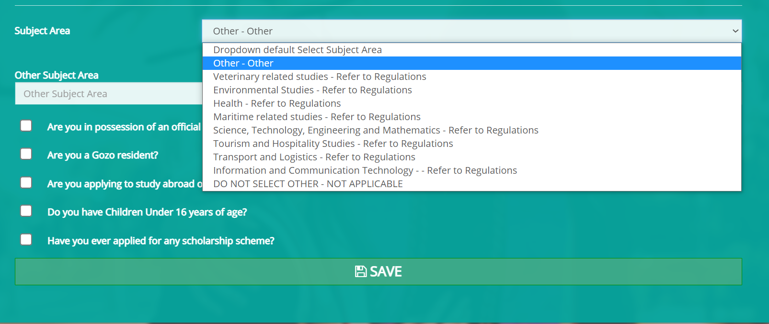
DO NOT SELECT ‘OTHER’ in Subject Area

Slide 7
Curriculum Vitae
Past Qualifications and work experience are to be clearly shown on CV
You gain marks for qualifications that are level 5 or higher. Marks are given only on the highest qualification.
You gain marks for work experience. Input clearly job descriptions and period of employment/voluntary work on CV

Slide 8
Declaration: Schedule I of the Regulations (pg 17)
The last page of the Regulations.
Do not upload any other self statement/declaration.

Slide 9
APPENDICES
Appendix I
A Motivational Letter on why applicant should be chosen for the ENDEAVOUR II Scholarship Scheme
Appendix II
The relevance of Study / Research including the Benefit to Malta vis a vis the current national priorities.
The Impact of Study /Research on the development of Malta.
Appendix III
These will help the Board to assess your application.
Make sure you do not upload duplicate appendices or blank documents.
Around 300 words each and upload in pdf. Make some research and you may seek academic/professional advice. Useful links may be found on website. Name each appendix accordingly.

Slide 10
Ineligible letters
(6 days to appeal)
Interviews
Deadline for documentation (19th October 2022)
Ineligible letters
(6 days to appeal)
Publication of Results
Information Meeting
Agreement
Closing of online application
Vetting
PROCESS

Slide 11
AVOID BREACHING THE REGULATIONS
Submit a correct application
Late applications will not be considered. The system shuts off automatically.
Uploading the right documentation.
Start date of course must not be before 20th June 2022.
Start date of course must not be after 30th June 2023.
Cannot opt for a university which is not listed on your application.
Those already in possession of a Masters degree may apply but cannot apply for a lower level ex. PG Cert./PG Dip.
Those already in possession of a Level 8 degree cannot apply
ULA, MQRIC reports and transcripts/certificates are to reach the office by not later than Wednesday 19th October 2022.
Recommended to go also through the other schemes and attend the online meetings

Slide 12
ULA as per Clause 3.29 (if awarded,the agreement will be based on the ULA provided by University)
Unconditional
Title of Course
Exact start and End dates ( ex. 4th September 2022 – 6th September 2023)
ECTS or the equivalent
Mode of study (ex. Full time/Part time/Distance Learning/Blended)
Number of obligatory visits abroad (applicable for part time/DL/full time in Malta)
Must reach the office by Wednesday 19th October 2022 (4.00 p.m)
Inform your university to e-mail us the required details above
Guidelines are also available on the website

Slide 14
MQRIC Recognition Statement/receipt of MQRIC statement
Mfhea.mt
For qualifications obtained from foreign universities/institutions. Marks are not given if this does not reach the office by Wednesday 19th October 2022 (4.00 p.m)
For the course applying for if it is carried out in a foreign university/institution (ineligible if this document does not reach the office by Wednesday 19th October 2022 (4.00 p.m)
Receipts issued by MQRIC office, are temporary accepted till Wednesday 19th October 2022 until the actual report is issued.

Slide 15
TABLE 1: EXAMPLES OF GRANTS
Where the prospective qualification is issued by a local university/institution:
Awardees shall be entitled for the first 30% of the amount as follows:
No. of ECTS | Full Entitlement (€58 for each ECTS) | 30% (1st payment) After signing of Agreement
60 ECTS | €3,480 | €1,044
90 ECTS | €5,220 | €1,566
120 ECTS | €6,960 | €2,088

Slide 16
TABLE 2: EXAMPLES OF GRANTS
Where the prospective qualification is issued by a foreign university/institution:
Awardees shall be entitled for the first 30% of the amount as follows:
No. of ECTS | Full Entitlement (€100 per each ECTS) | 30% (1st payment) after signing of Agreement
60 ECTS | € 6,000 | €1,800
90 ECTS | € 9,000 | €2,700
120 ECTS | €12,000 | €3,600

Slide 17
Type of Allowance | Modality | What Triggers the Allowance
Study Abroad Allowance | Full Time (Physical Abroad on Campus) | For Full time studies abroad on campus €4,000 per annum
 | Joint full time programmes where one of the institutions is in Malta and the other is a recognized foreign institution Part-Time/Distance/Blended | For visits of one month or longer, the allowance will be calculated pro-rata up to not more than €4,000 per annum
 | Joint full time programmes where one of the institutions is in Malta and the other is a recognized foreign institution Part-Time/Distance/Blended | For visits of less than one month, then the €200 per visit will apply up to not more than €2400 per annum
Persons with Disability | Fulltime/Part-Time/Distance/Blended | €2,000 p.a.
ADDITIONAL ALLOWANCES

Slide 18
The office will issue Claim Forms with payment details
After the 1st payment (30%), the interim payments will be processed upon confirmation from the university that the 30% are achieved and exceeded
Consequent claim forms are issued when the office is in receipt of confirmation from university that another number of ECTS’s have been achieved
PAYMENTS

Slide 19
20th June 2022- 15th July 2022(noon) : Applications
July/August: Issuing ineligible letters
August – September 2022: Interviews
19th October 2022 (4.00 p.m) : Deadline for documents.
October/November 2022: Ineligible Letters
Expected in November: Results - Information meeting will follow
Expected January 2023 - March 2023: Agreements
TIMEFRAMES
Expected February 2023 : Start processing Payments
TIMEFRAMES

Slide 20
Online application deadline - Friday 15th July 2022 (noon local time).
ULA, MQRIC reports, transcripts/certificates by Wednesday 19th October 2022 (4.00 p.m local time).

Slide 21
Tel: 153
Website: www.myscholarship.gov.mt
E-mail: endeavour.meyr@gov.mt
Address:
Ministry for Education,Sport,Youth,
Research and Innovation (MEYR)
Scholarships Unit Room 116
Great Siege Road
Floriana

Slide 22
GOOD LUCK

